Slide 1
Web Development
Node.js, Express
First Node site: Currency Converter

Slide 2
These slides and code:
https://github.com/claraj/currencyAPI

Slide 3
Node.js Site
Currency converter site, to convert (e.g.) US dollars to Euros or UK pounds
User will enter number, select currency to convert from; and currency to convert to
So, for example, if user wants to convert $50 to equivalent in Euros, server will look up conversion rate, and return a web page that shows the converted value

Slide 4
Required Software
Nodejs; from nodejs.org, latest LTS version
Add path to node executable to your path. Node probably did this during the install
Verify by typing the following at the command prompt or terminal, should see a version number. If error, stop and fix
node --version
Lab PCs: type
set PATH=%PATH%;C:\Program Files\nodejs

Slide 5
Install tools nodemon and express-generator
You only need to do this one time for one computer
express-generator sets up a template express project with basic setup done
nodemon automatically re-starts your server when you make changes
Type these commands in your terminal
npm install -g nodemon
npm install -g express-generator

Slide 6
Project Setup: VSCode/Sublime etc.
In your terminal, navigate to wherever you store your projects
Type
express --hbs currency
then
cd currency
then type
npm install
Open the files in the new currency directory in your editor.

Slide 7
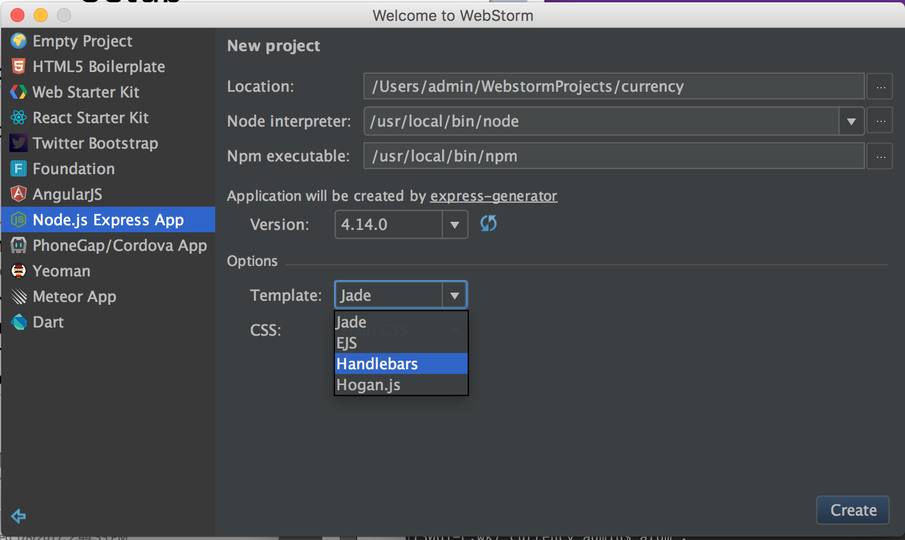
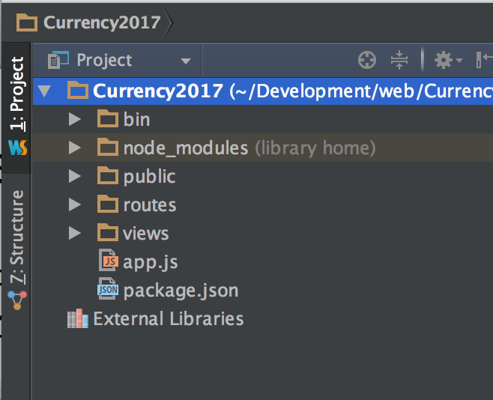
Project Setup: Webstorm
New Project > Node Express application
Select Handlebars for templates, defaults for everything else
Click Create

Slide 8
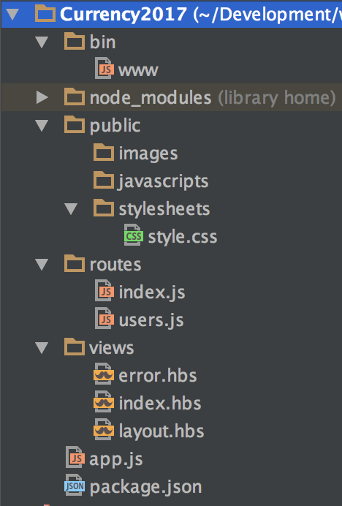
Files Created
app.js: main web app configuration
bin/www: code to run the server
public: images, javascripts and stylesheets - static things that are the same for every page
routes: code to handle different requests to your server
views: templates for generating HTML
package.json: data about your project, including list of dependencies
node_modules: directory for storing dependencies

Slide 9
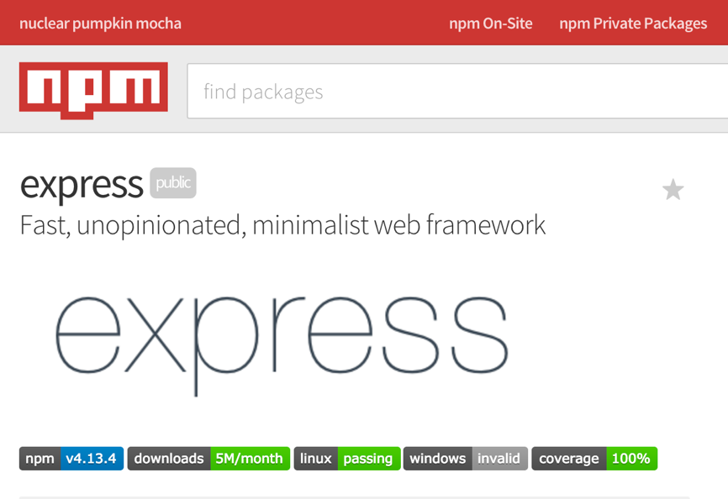
NPM – Node Package Manager
NPM is a command line tool that connects to the NPM package repository
Hosts 1000’s of packages that you can add to your app
https://www.npmjs.com/ Search for different packages that you can add to your app
Quality can vary – pick popular, well maintained modules
Where you can
find the correct version
of your dependencies
Express at NPM ->

Slide 10
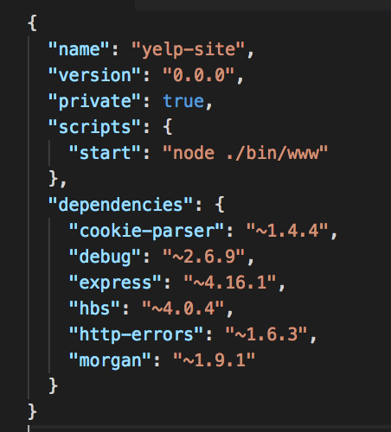
package.json
package.json contains info about your app
scripts - what script to run to start your app?
dependencies: what other packages are necessary to install to run your app?

Slide 11
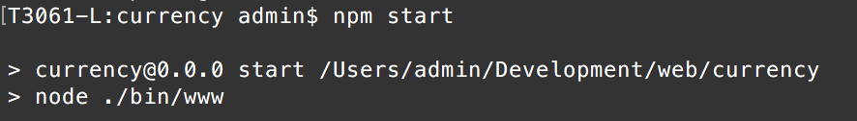
Run your server: Terminal
Terminal: from the currency directory, type npm start
To stop your server, press Control+C

Slide 12
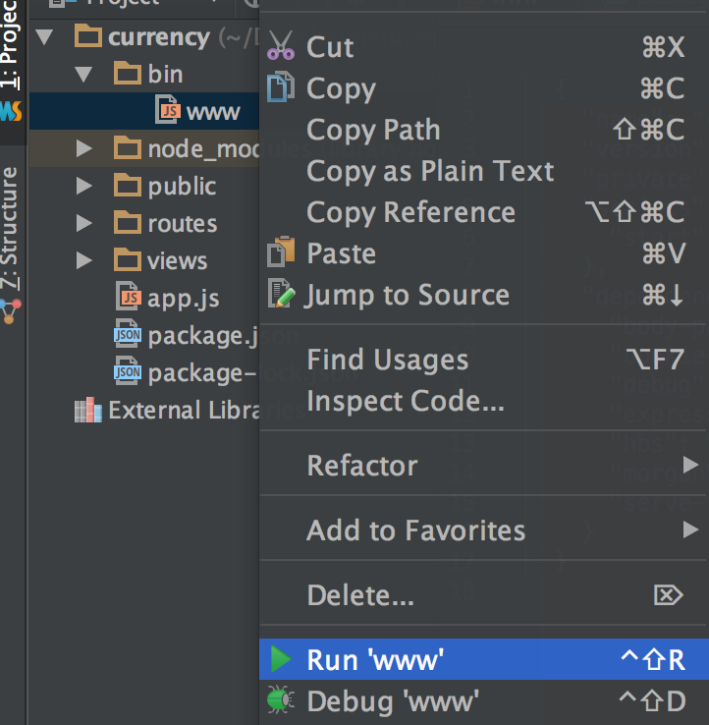
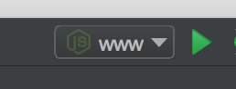
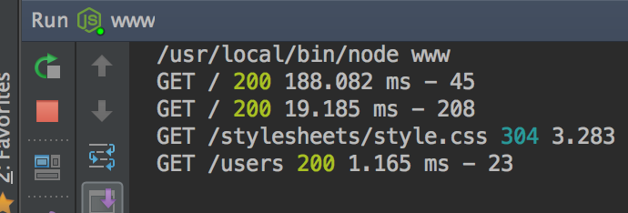
Run your server: Webstorm
Webstorm: right-click bin/www and select Run..
A run configuration will be created, next time you can click the play button in the menu bar
To stop your server running: click the red stop button

Slide 13
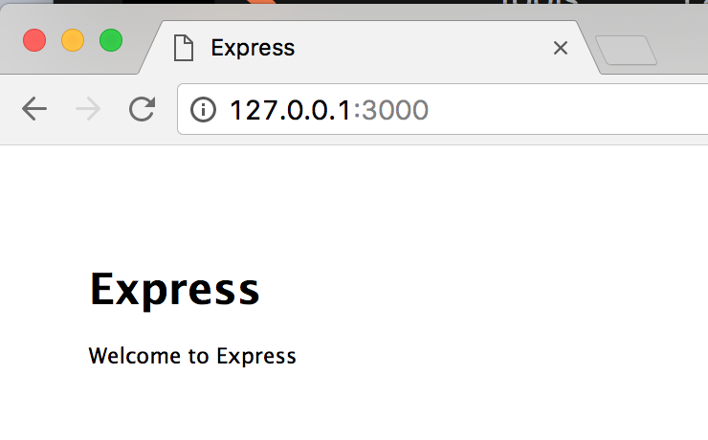
Browser
Open your browser and go to this address
http://127.0.0.1:3000/
"Welcome to Express" message? success!

Slide 14
Components of your app: app.js
app.js: main configuration file
Add and configure different modules for your entire app: this is where you can configure and add databases; template engine; cookie processing; POST form processing; session storage; logging, authentication….
The default app has some of these, we'll add others in future apps; there are many other modules too
At a high level, which URLs paths should be sent to which route handlers? Routing

Slide 15
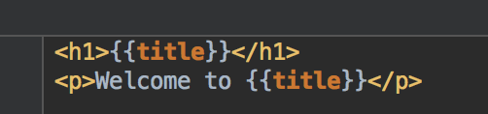
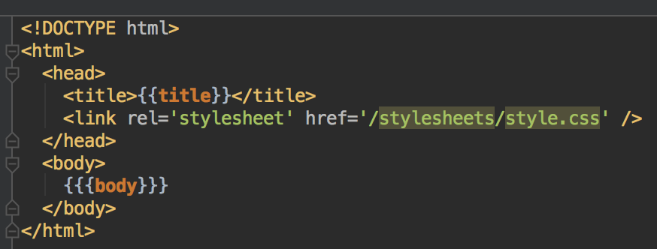
Components: views
views/index.hbs
views/layout.hbs
{{{body}}} is magically replaced with the text in index.hbs when a route renders index.hbs

Slide 16
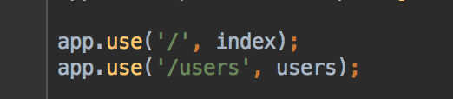
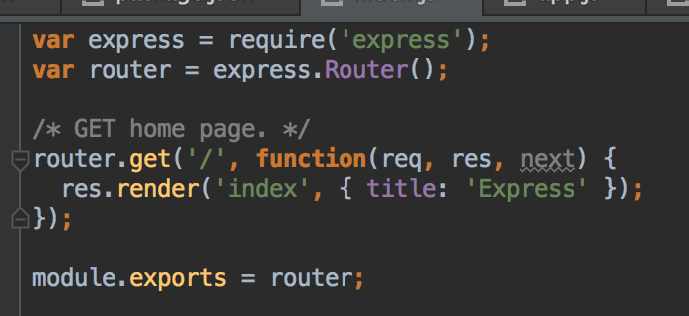
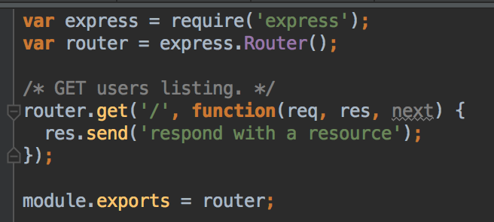
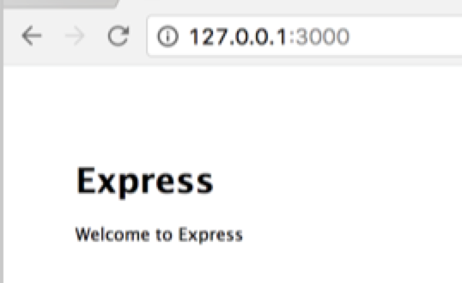
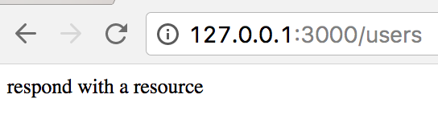
Components of your app: routes
routes directory: JS files to handle different routes - URL paths - for your app
app.js
routes/index.js
routes/users.js

Slide 17
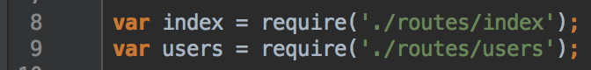
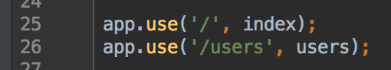
Where does the page come from?
Request arrives at bin/www and is passed onto app.js
app.js examines the path - everything after http://127.0.0.1:3000 in the URL - and decides which route JS file to send the request to
Your server doesn't care about the domain
So a request to the URL http://127.0.0.1:3000/ becomes a request to /
So a request to the URL http://127.0.0.1:3000/users becomes a request to /users
app.js has been configured to send every request starting with / to routes/index.js to find a route handler method. All of the handlers in routes/index.js will be checked,
and if there's a function that handles a request to this path, then this function will be called to handle the request and provide a response
If there is no match, control returns to app.js to try the next routes file - /users/
If there is still no match, a 404 not found response is returned

Slide 18
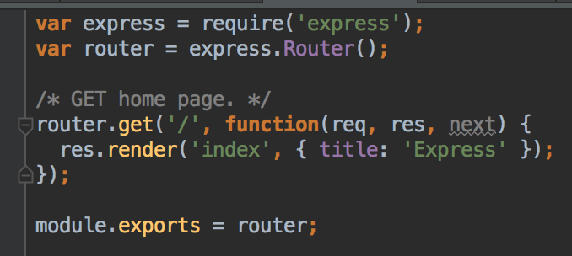
routes/index.js
app.js passes the request to index.js
The request is a GET request to the path '/'
index.js checks to see if the request to GET '/' matches any of the route handlers it defines
Yes - it matches this route
verb is GET
path is '/'
Route handler

Slide 19
routes/index.js
The callback function in the matching route handler runs to provide a response to this request
Takes 3 arguments
req a request object, contains info about the request
res a response object, used to create the response
next a function that can be used to call the next route handler. If this route will not handle the entire request, next() is used to send the request on to another route handler. e.g. if there's an error, it can pass the request onto the error handler to show a 500 or 404 page

Slide 20
routes/index.js
The callback function in the matching route handler runs to provide a response to this request
The example route renders and template for the response
rendering: take template and data, put them together, and output HTML
res.render() takes the name of a template plus an optional object, and outputs a HTML page
www will send this response (including the HTML page and the default status code, 200) to the client

Slide 21
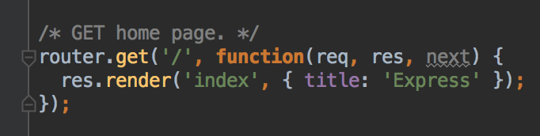
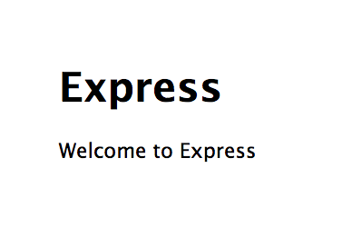
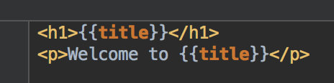
Templates
views/index.html
Attributes in your object match placeholders in your template
In this example, data is hardcoded in the template, but in can also be fetched from a database or another server; and vary depending on data in the request

Slide 22
Templates
Template engines combine data plus template to make HTML
Various templating languages with different syntax; most use {{ }} to indicate placeholders for data
EJS, Jade, Handlebars… other web app frameworks have their own template languages e.g. Jinja with Flask
Templates can have placeholders for data
Conditional Logic: e.g. if a piece of data exists, display it, if not display a not found message
Loops: e.g. create a row in a table for each item in an array
Helper functions, formatters help format data; produce more complex HTML from the data e.g. capitalize text; format dates...

Slide 23
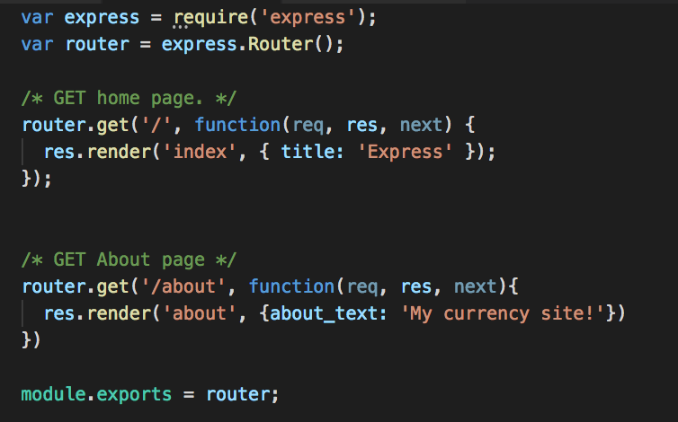
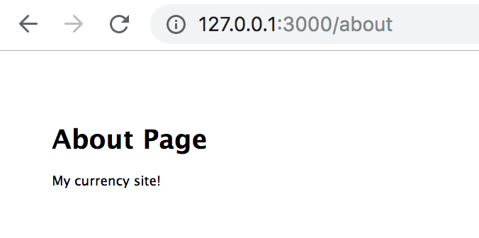
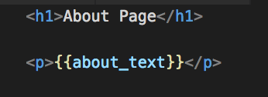
Adding another page
Decide on the URL for that page
For this example /about
Add a route handler, in routes/index.js
Create another template file, views/about.hbs
routes/index.js
You can change this to any text you like
views/about.hbs
Restart your server and go to 127.0.0.1:3000/about

Slide 24
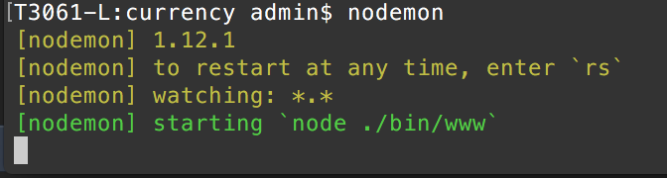
Restarting your server
nodemon watches you project files and automatically restarts your server when a file changes
Either in your terminal, or in Webstorm's terminal, make sure you are in the currency directory, and type
nodemon
Press Control+C to stop your server when done
Avoid leaving your server running when not working on it
You can only run one server at one port at a time
Lab PCs, nodemon may not work, start and stop your server with npm start or play button in WebStorm

Slide 25
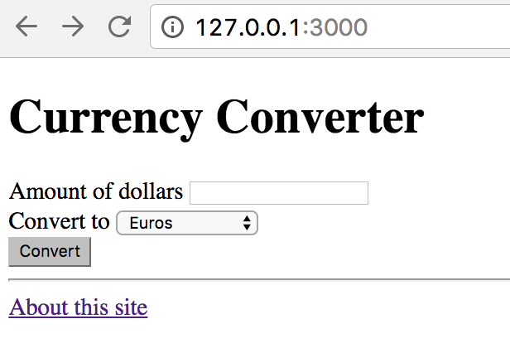
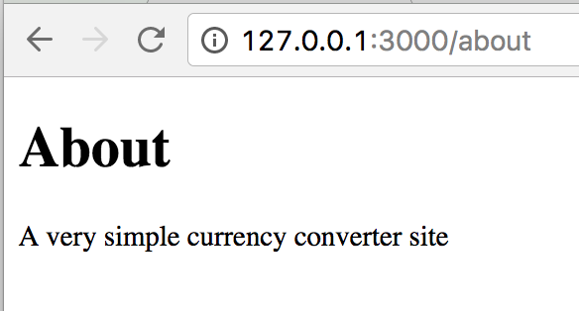
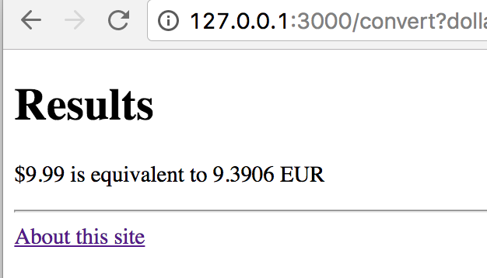
Reminder: goal is to build a currency converter site

Slide 26
Build the home screen template
A page with a form
Input for the amount of US dollars
Dropdown for the currency to convert to
Submit button to send the request to the server
Replace the code in views/index.hbs with the following -->

Slide 27
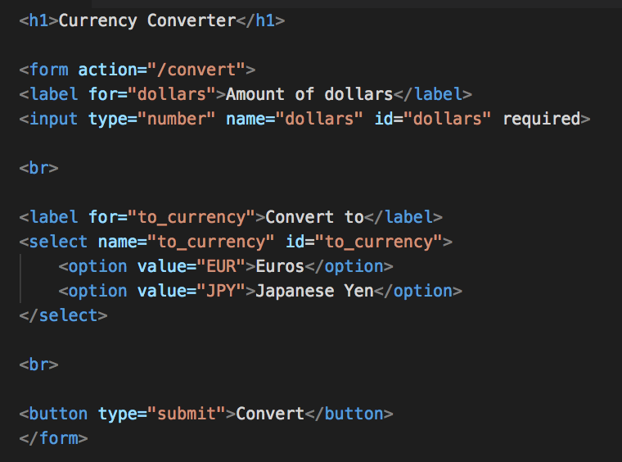
views/index.hbs Delete all the existing text and replace with this HTML

Slide 28
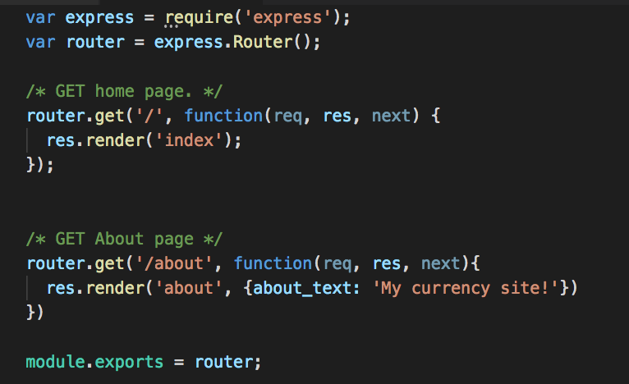
routes/index.js
Modify the GET request to the home page
Don't need to send any data, just the template's name

Slide 29
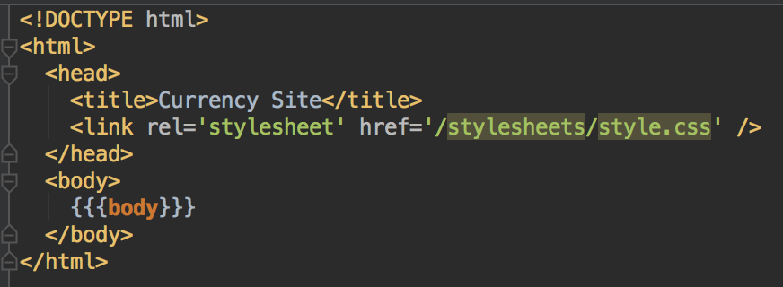
Modify layout.hbs
Change the {{ title }} to the text "Currency Site"
So we don't need to send a title for each page
If no data is provided for a placeholder, it will be undefined in the template; that may or may not cause errors

Slide 30
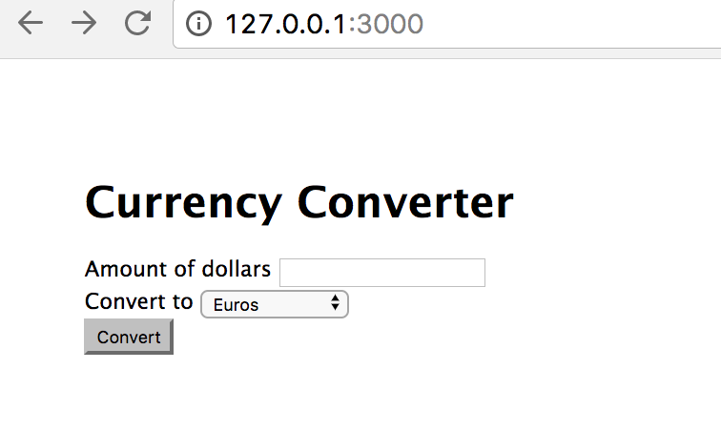
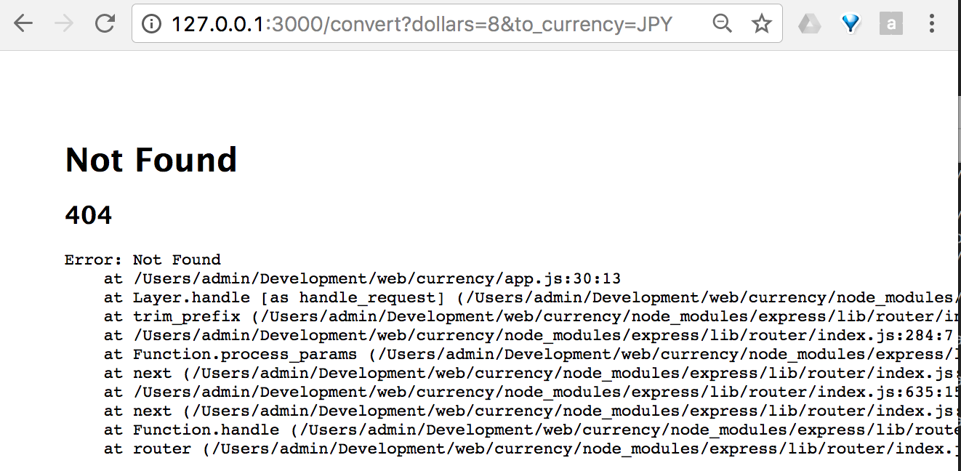
Check your home page
Should see a form
What happens when the button is clicked?
Note the URL the browser requested

Slide 31
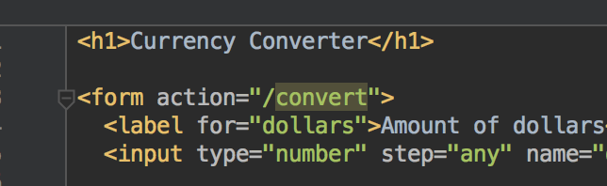
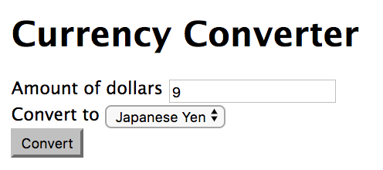
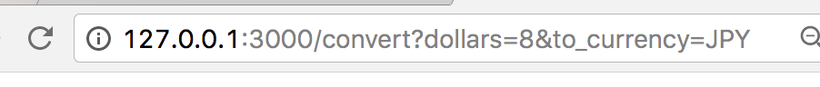
Requests
Clicking on the form submit button generates a new request to your server, to the URL path given by the form's action attribute. The browser does this
The request includes the form data, as key-value pairs
Text encoded into valid URL format; pairs separated by & characters
Keys are the name attributes of the input or select elements
Values are the data entered or selected
Example, converting 8 dollars to Japanese Yen creates this request to /convert

Slide 32
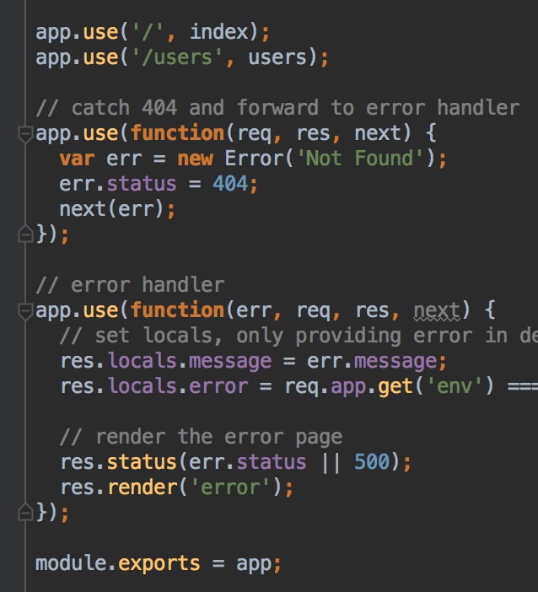
Error Handling: Not Found
app.use with no path argument matches all request paths
At the moment, clicking the button gives you an error message
There's no route that matches /convert
When app.js tries to route this request, it checks through the list of routes, and gives it to the first match
app.use('/', index) does match, but there's nothing in index.js that can handle the request to /convert, so it's passed back to app.js
/users doesn't match either, so it tries the 404 error handler, which does match
Status code set to 404 (Not Found)
Call next(err) to pass the request to the next route handler in turn
app.js will keep trying to match this request to a route
It matches the error handler; which renders an error page
We'll invoke the error handlers when needed in future apps
There's some tricky concepts here, but you'll get more practice with future apps

Slide 33
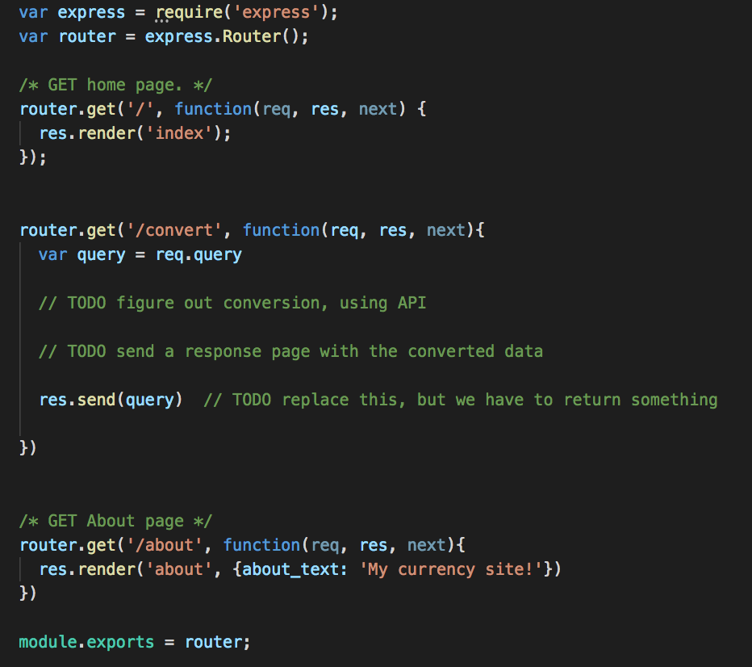
Create a new route: routes/index.js
Add the new route handler for /convert
to
routes/index.js
Every route must send a response or pass the request to the error handler(s)

Slide 34
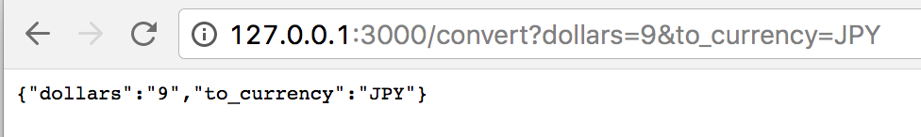
Now try clicking the button
No error, the query string is echoed back to the client.
req.query holds the data in the query string, converted to an object
Note that it's an object with the key-values pairs from the form, as strings
This response isn't very useful, so let's work on doing the conversion

Slide 35
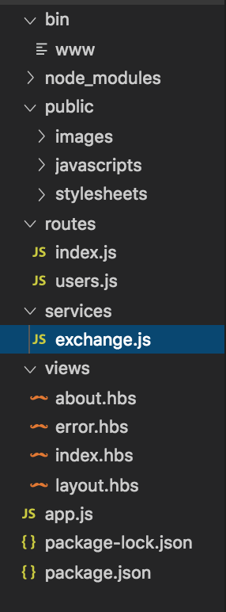
Where's the data going to come from?
Make a new directory called services
In model, make a file called exchange.js

Slide 36
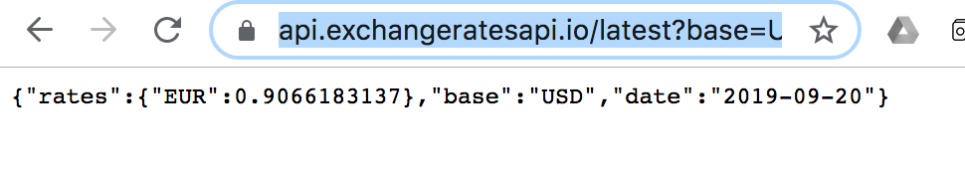
Get exchange rate data from API
https://exchangeratesapi.io/
Example request:
https://api.exchangeratesapi.io/latest?base=USD&symbols=EUR
Returns a JSON response

Slide 37
Install axios
Library to make API requests from node.js
Command prompt: Stop your server
npm install axios

Slide 38
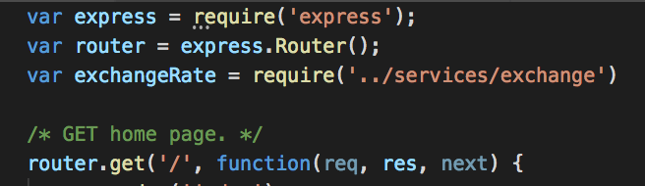
routes/index.js
Require services/exchange
Whatever was exported from currencyDB.js will be available in index.js as exchangeRate
In this case, it's a function that connects to the API

Slide 39
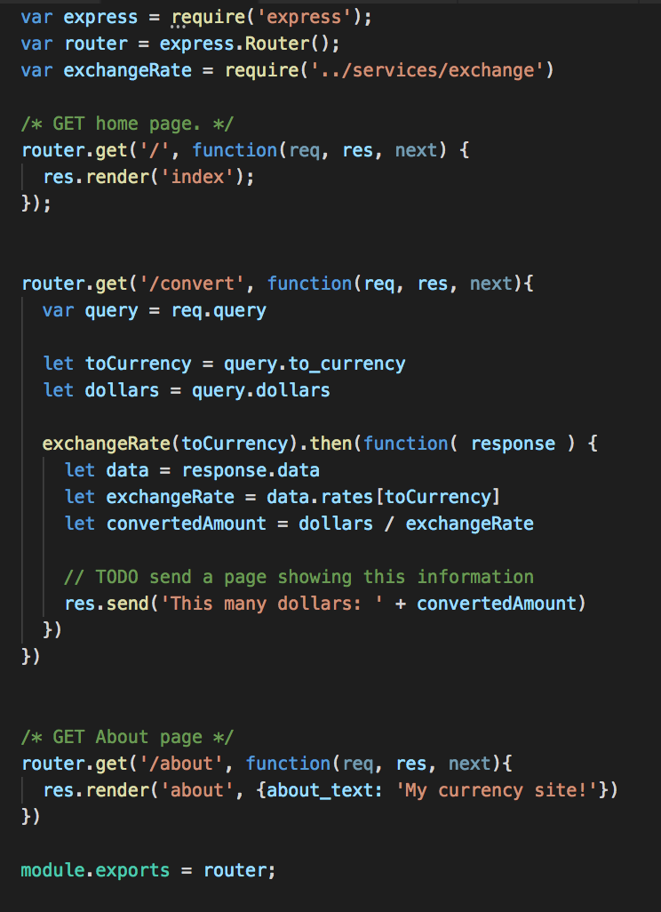
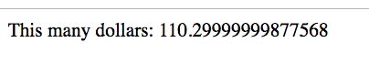
Require whatever is exported from exchange.js file, with the name exchangeRate
Try your site - what happens when you do a conversion?
Example: converting 100 dollars to Euros:

Slide 40
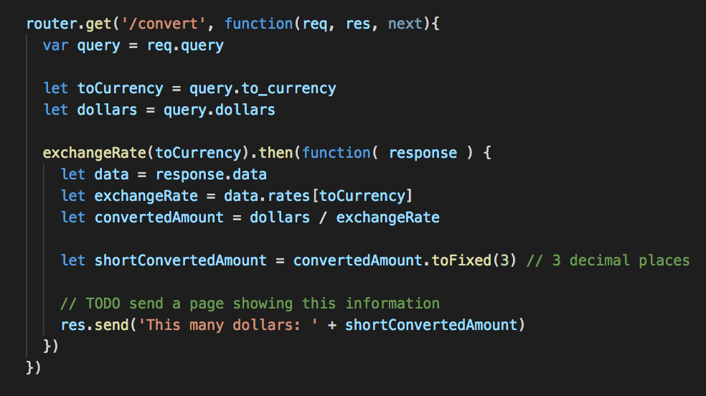
Too many decimal places?

Slide 41
Make a template to show the result
res.send() sends a plain text response
Which your browser can display, but it's not a web page, it is not HTML
So, in the views directory, create a new file called results.hbs

Slide 42
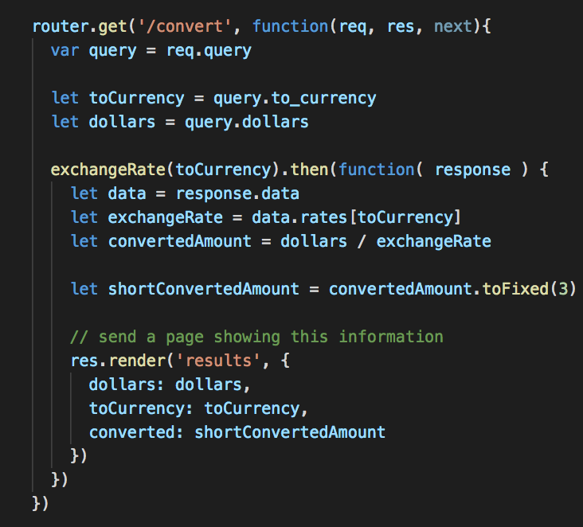
Modify the route routes/ index.js)
replace res.send with res.render, include data

Slide 43
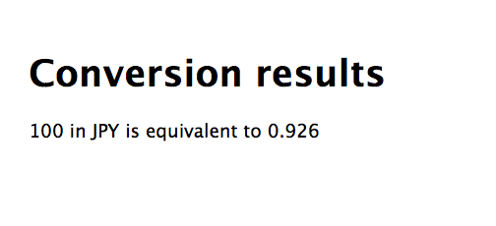
Run and test
Should see your data in the new result template, for example:
Can re-organize your template as desired, add styles, more content…
Important! The data is separate from the page layout and structure - they can be modified independently

Slide 44
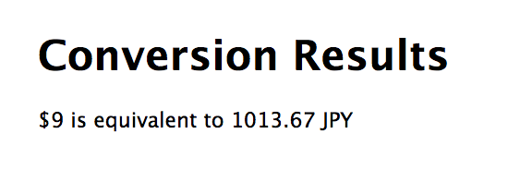
Modifying the template
You can put any HTML in your template
Can organize your template any way you like
Your turn: change results.hbs so the paragraph's text is in the format
$9 is equivalent to 1013.67 JPY
You don't need to modify routes/index.js

Slide 45
Linking the about page
We'd like both pages to have a footer with a link to the about page
We could modify both pages and add a link
But that's going to get tiresome for lots of pages
Utilize the layout.hbs layout file
When a page (e.g. about.hbs) is rendered, Handlebars will:
look for a file called layout.hbs
replace {{{body}}} with the text in about.hbs to create a template
render the resulting template by filling in placeholders with data provided
So we can use layout.hbs to write content that's common to every page, useful for
Including CSS or scripts every page needs
Headers or navigation
Footers
Setting the title
For larger sites, can have more layout files, for example, a different layout file for different sections of the site

Slide 46

views/layout.hbs
Modify to add a footer with a link to /about

Slide 47



Run and test
Check the link is working, is on all the pages

Slide 48

Your turn
Can you add a link to the home page in the footer?
What's the URL for the home page?

Slide 49
What other features might we need?
Images
Stylesheet

Slide 50

Styles
Notice that layout.hbs links to /stylesheets/style.css
This stylesheet is applied to all the pages generated from this layout - by default, that's all of them
If you want to apply different styles for different parts of your site, you'd create separate layouts

Slide 51


public/stylesheets/style.css
Add or modify styles of your choice
I changed the link and background colors
Use any styles of your choice

Slide 52


Images
Would like to add image as the background
Add another image to About page
I used these: you can right-click and save from this PowerPoint; or use images of your choice
About page: money-cat.png
background: call it money.png

Slide 53

Images
Add your site's image resources in the public/images/ directory
Save money-cat.png and money.png in public/images

Slide 54



Add about image to views/about.hbs
views/about.hbs
public/stylesheets/style.css
Optional - scale the image so it will shrink to fit if the window is smaller than the picture

Slide 55

Adding the money.png image as a background
public/stylesheets/style.css

Slide 56

Adding the money. image as a background
Check site

Slide 57
Challenge
Instead of converting from dollars to target currency, can you add another drop-down box to select target currency?
You'll need to modify the route handler, and the code in services/exchange.js

Slide 58
Entire site is at…
https://github.com/minneapolis-edu/web-currency-hbs

Slide 59


Version control
In the currency directory, create a file called
.gitignore with the text node_modules/
This tells git to ignore node_modules
You REALLY don't want to add these files to your repository (they are huge and can cause problems when we deploy our sites)
If you provide a package.json file, anyone who uses your project can run npm install to fetch and install the correct node modules

Slide 60
Version control: Command Line
Create a GitHub repository
At command line/terminal, make sure you are in root directory of project
Type the following, replace githubURL with your GitHub repository URL
git init
git add .
git commit –m "Currency site"
git remote add origin githubURL
git push –u origin master

Slide 61
Version control: Webstorm
Create a GitHub repository
VCS > Import into version control > Create a Git repository
Add all of your files
Verify node_modules was ignored
Commit and push to GitHub

Slide 62
Deploying to Heroku

Slide 63
Heroku
"Platform as a service"
Create servers, or "dynos" to host web applications
Get 5 free dynos with a free Heroku account
Sign up at Heroku
https://www.heroku.com/
Install Heroku command line tools
https://devcenter.heroku.com/articles/heroku-cli#download-and-install
Lab PCs: should have but may have errors - we can try though

Slide 64
Let's add To Do app to Heroku
Ensure app has GitHub repository
Configure Procfile
Verify dependencies
Create Heroku app
Deploy app to Heroku

Slide 65

Create Git Repository
Create a .gitignore file in the root directory of your project
It contains the line node_modules

Slide 66
Create Git Repository
Create a git repository
Add the rest of your files to your repository
Optional:
Create a GitHub repository
Push your code to GitHub

Slide 67

Create Procfile
Plain text file with command to run your app
Either create Procfile in root directory of project, and add the following
web: node bin/www
Or, from root directory of project, type
echo "web: node bin/www" > Procfile
This use of the echo command will copy the text given to a file called Procfile.
Neat shortcut for creating .gitignore files too

Slide 68

Verify dependencies: package.json
Verify you have all of your app's dependencies listed in package.json
We added axios, make sure it's listed
If your versions are higher than these, no problem
Heroku will use package.json to install the necessary dependencies

Slide 69
Add files to git
Add Procfile, any updates to package.json, and any other code updates to your git repository
commit your changes

Slide 70
Create app
Verify you have Heroku Command Line Tools installed
Make sure you are in the root directory of your project
From the root directory of your project, type
heroku apps:create

Slide 71
Deploy to Heroku
Push to Heroku
git push heroku master

Slide 72

Deploy to Heroku
Open app in browser
heroku open
Your site should be live!

Slide 73

Live site
Mine's at https://desolate-sands-34640.herokuapp.com/

Slide 74
Also test locally: should still work
Either run as normal with nodemon or npm start or click Play button in WebStorm
or
heroku local web
2nd option is useful for testing Heroku Procfile and configuration
Problems? Check your logs with
heroku logs

Slide 75
Summary - lots of things!
NPM, package.json, dependencies
nodemon
Express
Routes and routing
Templating with Handlebars
Creating HTML, placeholders for data
layouts - common template shared by site
APIs
Exporting and requiring
Static resources: images and CSS

